Slide 1
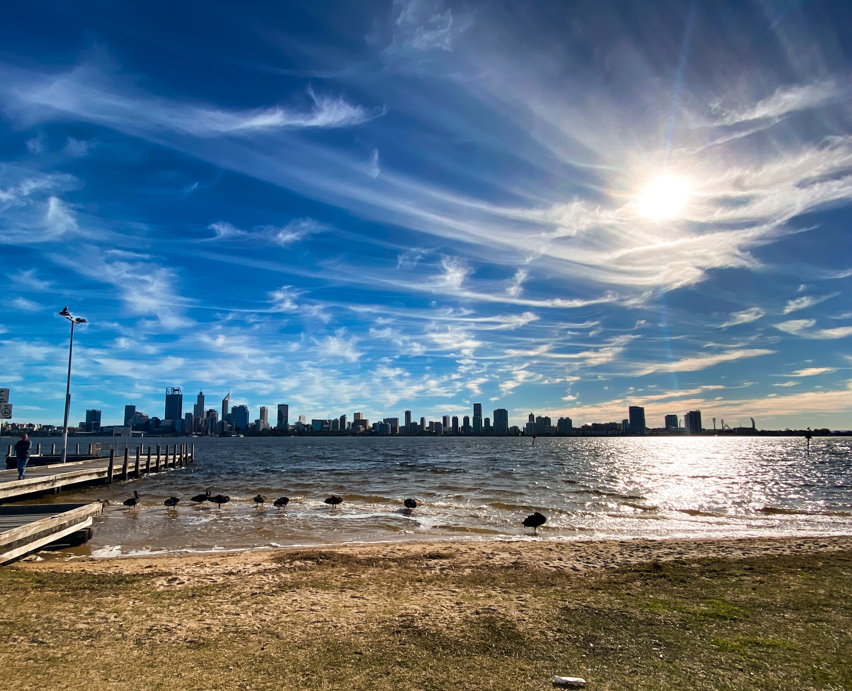
House Hunting in Perth Using k-Means clustering to find your next home

Slide 2
INTRODUCTION
Finding a house to buy is never an easy process and these days, location is everything.
House hunters want to live somewhere that matches their lifestyle; they want somewhere full of artisan coffee shops or to be surrounded by art museums and theatres.
But how do they find such places?
Currently, online house hunting tools only offer buyers the option to search for their next home based on number of bedrooms, bathrooms and car spaces.
What if house hunters could access a tool that showed them neighbourhood characteristics such as what kind of venues are popular or what the median house price is in that area?

Slide 3

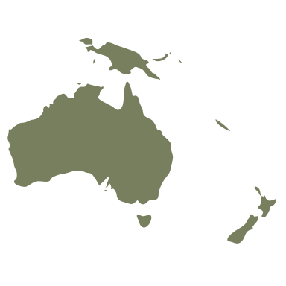

Data
Foursquare venue data will be used to create a profile for each neighbourhood, based on most common venues
Australian postcode and neighbourhood data will be used to display these profiles on a map of Perth
Western Australian Median House Price data will be utilized to give users an idea of whether a neighbourhood is in their price range

Slide 4
Methodology
Venue data was obtained for each neighbourhood in Perth
Venues were grouped by category, allowing the mean frequency of occurrence of each category to be calculated
K-Means clustering was used to cluster the neighbourhoods based on their venues and descriptive titles were assigned to each cluster
Median house prices for each neighbourhood were used to calculated the percentage difference of each neighbourhoods median price to that of the Perth average

Slide 5
RESULTS
Clustering resulted in 6 neighbourhood profiles:
Café Haven
Shopping Oasis
Convenient Living
Coffee & Yoga Enthusiasts
Fitness & Entertainment
Family Friendly

Slide 6
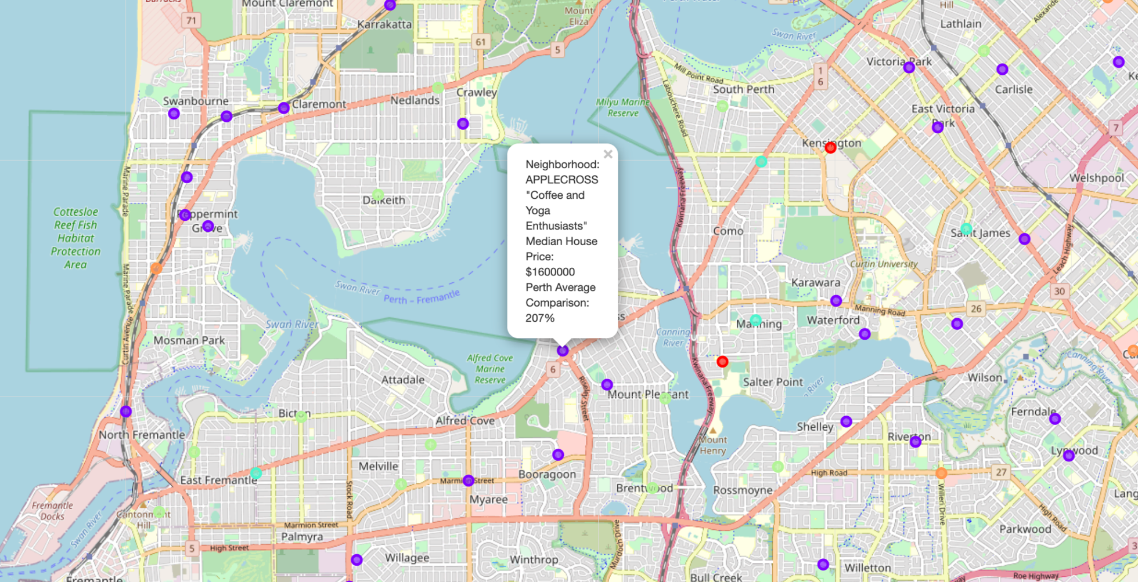


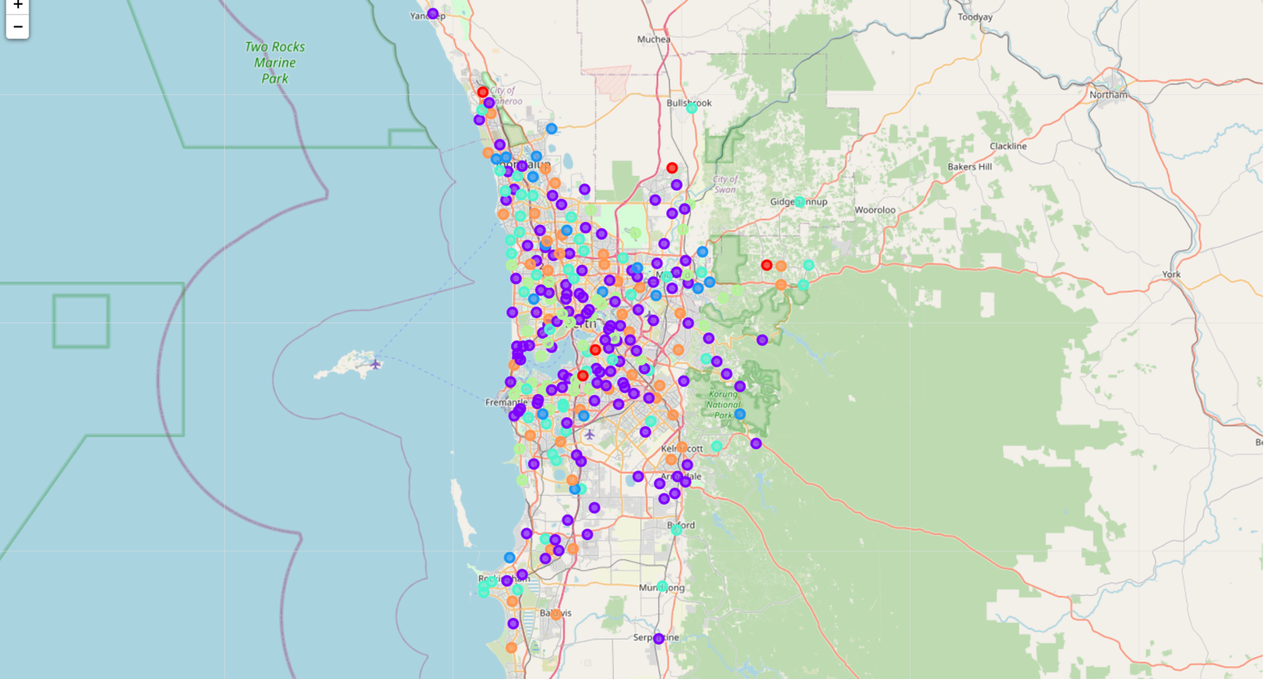
RESULTS
Labels provide cluster name, median house price and comparison to Perth average
Each cluster presented as a different colour on the map

Slide 7
DISCUSSION & conclusion
Overall, the map provides users with;
A visual representation of neighbourhood profiles
Pricing indications
An easy way to explore different areas of Perth
The map has incredible potential for;
Expansion to other cities
Inclusion of venue rating data
Addition of crime statistics
Links to real estate websites for current property listings

